Slide 1
Schedule
Sept. 5 (9AM-11AM) | Sept. 7 (3PM-4:30PM)
Sergio B (BH1106) | Sergio B (MH2110)
Modes of Inheritance | GWAS (Theory)
Week 1
Week 2
Sept. 11 (9AM-11AM) | Sept. 12 (9AM-11AM) | Sept. 13 (3PM-5PM) | Sept. 14 (9AM-11AM) | Sept. 15 (9AM-10AM)
Martin K (BH2110) | Yin Shen (BH2110) | Vijay Ramani (BH2110) | Jill H (MH1108) | Sergio B (MH2110)
Functional genomics | Epigenomics | Single Cell Genomics | Immunogenetics | GWAS (Lab)

Slide 2
Genetics and Genomics Module Modes of inheritance
Sergio.Baranzini@ucsf.edu

Slide 3
Objectives
To define complex genetic disease/trait
To understand current thinking about the architecture of complex traits
To understand how to identify genetic determinants of complex traits
To evaluate evidence for association between a gene and trait
To differentiate between research significance and clinical utility

Slide 4
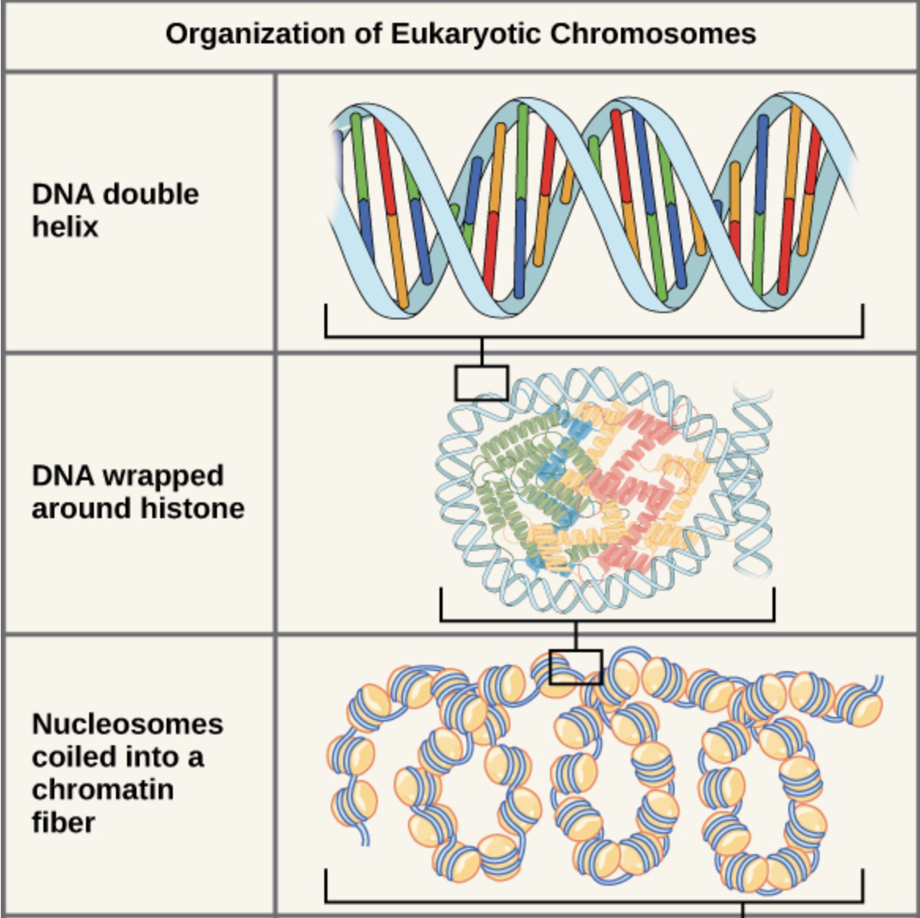
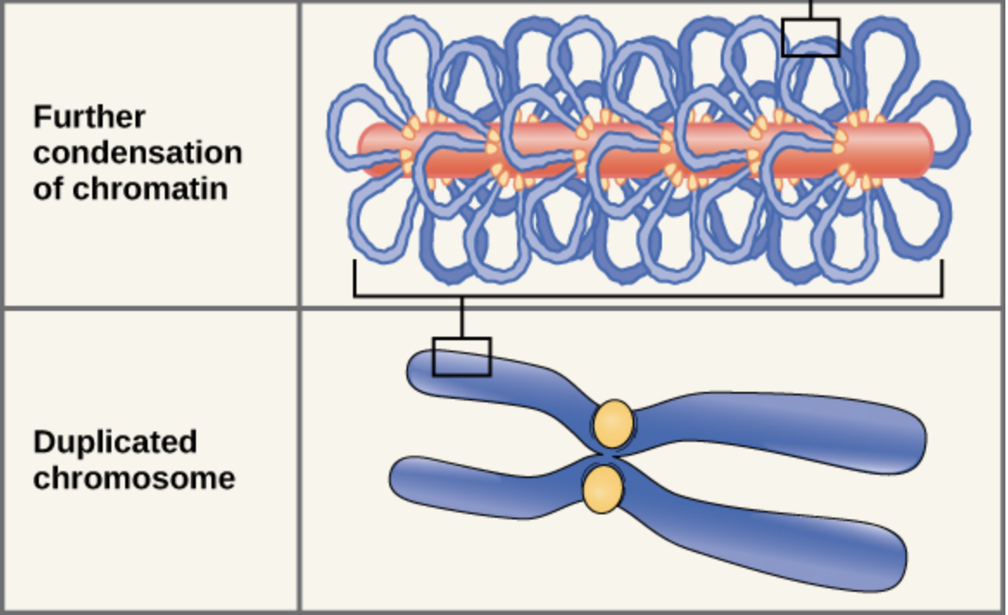
Remember the basics?

Slide 5
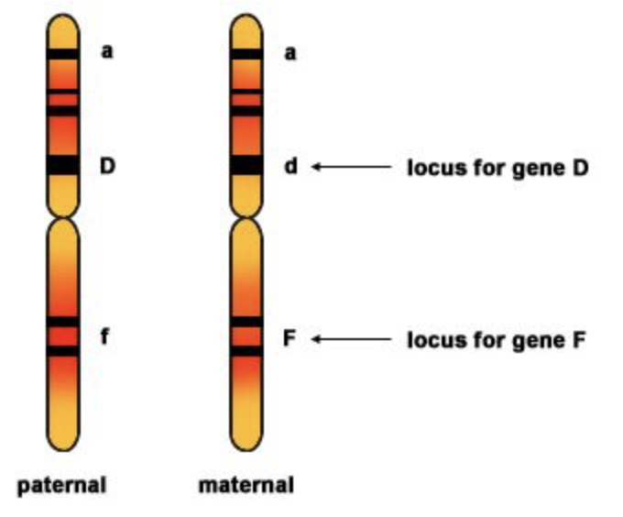

Slide 6
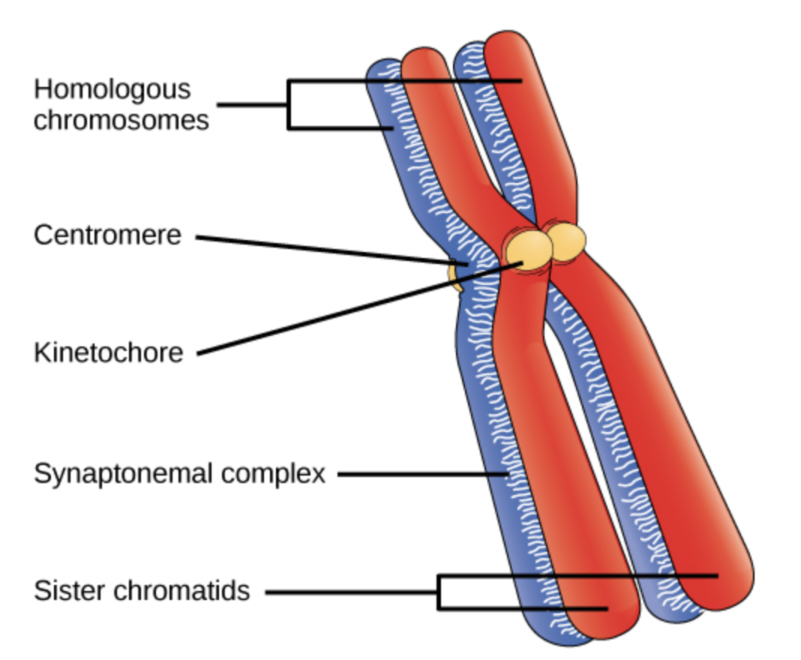

Slide 7
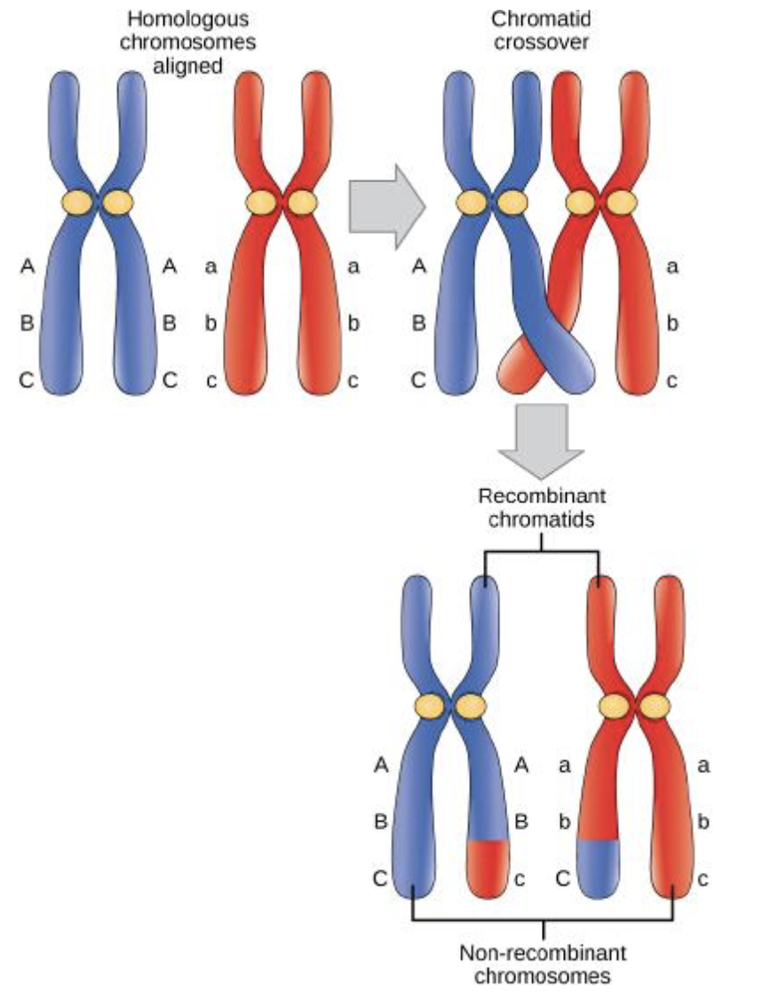
Meiotic crossover

Slide 8
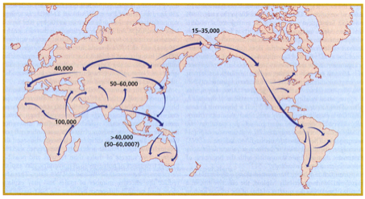
Out of Africa

Slide 9
Yr. BP x 1000
Modern human origins
200
Population divergence
150
Migration out of Africa
75-100
LD
LD
30-40
15-30
NE Africa EU AS AM OC
------ Sub Saharan Africa -------
Tishkoff and Williams Nat Rev. Genet 2002

Slide 10
Northern European chromosome
African chromosome

Slide 11
Modes of Inheritance
Inheritance patterns describe how a disease is transmitted in families.
These patterns help to predict the recurrence risk for relatives.
In general, inheritance patterns for single gene disorders are classified based on whether they are autosomal or X-linked and whether they have a dominant or recessive pattern of inheritance. These disorders are called Mendelian disorders, after the geneticist Gregor Mendel.

Slide 12
Mendelian Traits
disease
gene
Everyone with mutation is affected
Mutation is sufficient
Everyone without mutation is unaffected
Mutation is necessary
Mutations are easy to recognize
Affection status is easy to define
Environment plays little role

Slide 13
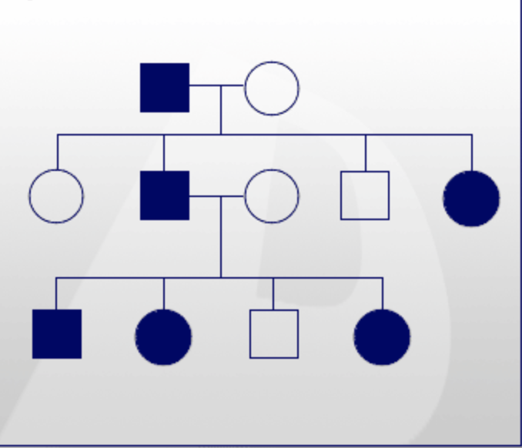
Autosomal Dominant Inheritance
Only one copy of a disease allele is necessary for an individual to express the phenotype.
With each pregnancy, there is a one in two (50%) chance the offspring will inherit the disease allele.
Unless a new mutation has occurred, all affected individuals will have at least one parent who carries the disease allele.
Autosomal dominant inheritance is often called vertical inheritance because of the transmission from parent to offspring.
Males = Females.
Male-to-male transmission can be observed.
Examples: myotonic muscular dystrophy and Huntington disease.

Slide 14
Autosomal Recessive Inheritance
Two copies of a disease allele are required to express the phenotype.
Typically, the parents of an affected individual are not affected but are gene carriers.
With each pregnancy of carrier parents:
There is a one in four (25%) chance the offspring will inherit two copies of the disease allele and will therefore express the phenotype.
There is a one in two (50%) chance the offspring will inherit one copy of the disease allele and will be a carrier.
There is a one in four (25%) chance the offspring will inherit no copies of the disease allele and will not express the phenotype or be a carrier. This individual would not be at risk for passing the disorder on to his/her offspring.
Males = Females
Examples: sickle cell anemia and cystic fibrosis.

Slide 15
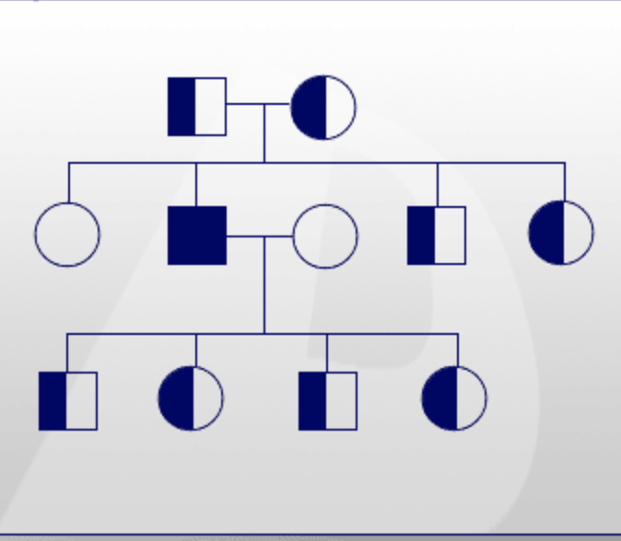
Autosomal Recessive Diseases (cont’d)
Most common in consanguineous relationships
More frequently observed in individuals of certain ethnic backgrounds than others because these individuals are descendants of the same ancestors.

Slide 16
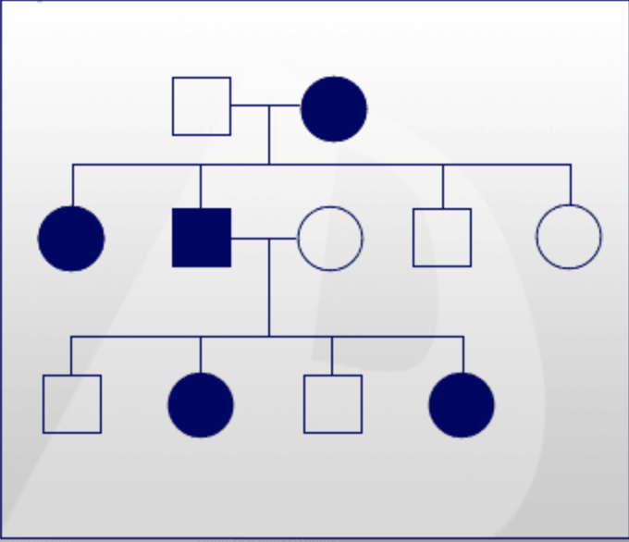
X-Linked Dominant Inheritance
Only one copy of a disease allele on the X chromosome is required.
Males = females, although males may be more severely affected (some are lethal).
When a female is affected, each pregnancy will have a one in two (50%) chance for the offspring to inherit the disease allele. When a male is affected, all his daughters will be affected, but none of his sons will be affected.
Examples: Hypophosphatemic ricketism, oral-facial-digital syndrome type I, and Fragile X syndrome.

Slide 17
Oral-Facial-Digital syndrome type I
A disorder characterized by oral, facial, digital, brain, and kidney manifestations.
The clinical features include oral (lobed tongue, cleft palate, hypodontia and other dental abnormalities), facial (hypertelorism, hypoplasia of alae nasi, cleft lip, micrognathia), digital (brachydactyly, syndactyly, clinodactyly, duplicated hallux, polydactyly), brain (atrophy, agenesis of corpus callosum, Dandy-Walker malformation), and kidney (polycystic kidney disease) manifestations. Affected males are usually miscarried.
The incidence of OFDI is approximately 1 in 50,000.
The gene is called OFD1 and is located at Xp22.3-p22.2.
Approximately 75% of cases are sporadic and males are usually miscarried.

Slide 18
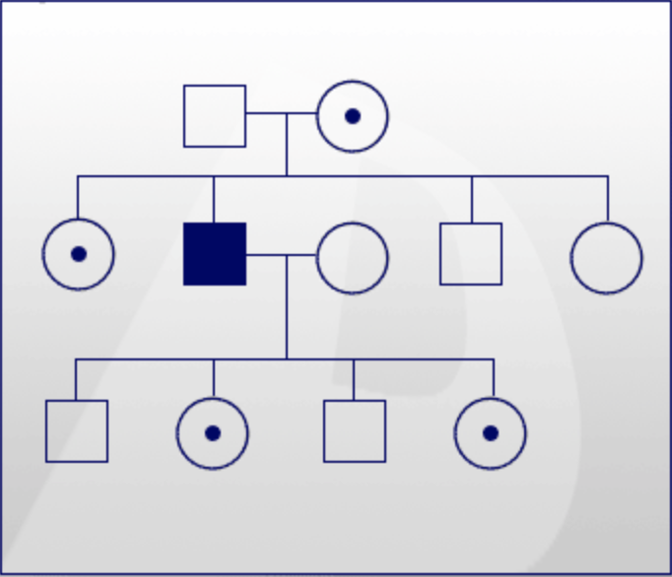
X-Linked Recessive Inheritance
Two copies of a disease allele on the X chromosome are required for females to be affected
Since males are hemizygous for X-linked genes (they have only one X chromosome), any male with one copy of an X-linked recessive disease allele is affected.
Females are usually carriers because they only have one copy of the disease allele. Affected males are related through carrier females.
For a carrier female, with each pregnancy there is a one in two (50%) chance her sons will inherit the disease allele and a one in two (50%) chance her daughters will be carriers.
Affected males transmit the disease allele to all of their daughters, who are then carriers, but not to their sons.
Women are affected when they have two copies of the disease allele. All of their sons will be affected, and all of their daughters will be unaffected carriers.
Examples: Duchenne muscular dystrophy, hemophilia A and hypohidrotic or anhidrotic ectodermal dysplasia

Slide 19
Duchenne muscular dystrophy
Progressive muscular degeneration
Onset in early childhood. Enlarged calves, failure to thrive, cardiac manifestations
1:3000 newborns.
Gene DMD, located n Xp21.3. 79 exons (more than 1Mb)
To allelic conditions -> DMD/Becker:
Females who are carriers for the X-linked form may have partial expression
Mutations are usually clustered, but could happen anywhere in the gene.

Slide 20
(Non-inherited) Mendelian Genetics
de novo mutation

Slide 21
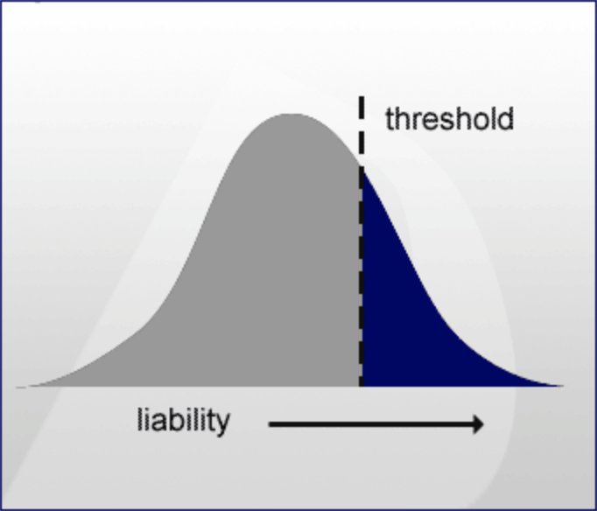
Complex Inheritance
Complex disorders (once known as multifactorial disorders) are caused by the interactions of variations in multiple genes and environmental factors.
The genes involved may make a person susceptible to the disorder, and the environmental factors may trigger this susceptibility.
The liability to exhibit the phenotype of the complex disorder is determined by both genetic and environmental factors.
Complex disorders are often common disorders in the population and include heart disease, multiple sclerosis, diabetes, asthma, and many birth defects, such as cleft lip +/- cleft palate.

Slide 22
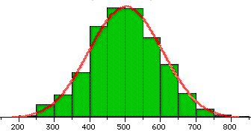
Complex Traits
genes
QTs
environment
disease

Slide 23
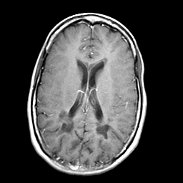
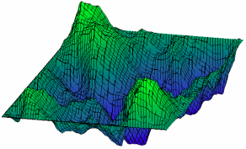
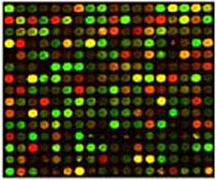
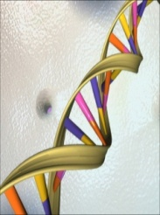
Hierarchical organization of biological complexity
Physiological/pathological
Process (health/disease)
high
neurodegenerative
metabolic
autoimmunity
cancer
infectious
Cell cycle
apoptosis
Cellular
process
Cell differentiation
pathways
proteins
low
Phenotype
expression
Genotype
genomic
Notes:
Hierarchical organization of complex organisms. (arrow depict the direct and indirect relationships across different levels)
Several different datasets are available at different levels and it is generally difficult for any single individual to keep up with these new developments across many different specialties.
I believe that its integration is likely to produce important new knowledge no only in MS but also in other complex diseases.
Inferences can be made between different levels.
In genetic analysis, genotype is correlated with a higher order trait.
The more immediate the phenotype to the genotype, the most likely that association is causal. But it is less likely that that association is specific (gene expression is not specific to MS).
Linking MRI with MS is a compromise between a lower level phenotype (than the disease trait) (thus, more immediate to causation) and a high specificity for the disease trait.

Slide 24
Complex Traits
No clear segregation pattern in families
Genetic heterogeneity
Allelic heterogeneity

Slide 25
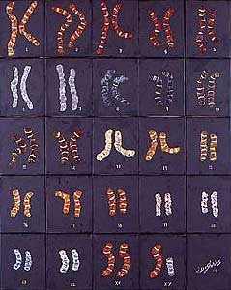
Complex Traits
Genetic Heterogeneity
Allelic Heterogeneity

Slide 26
Complex Traits
No clear segregation pattern in families
Genetic heterogeneity
Allelic heterogeneity
GxG, GxE
Low penetrance, variable expressivity
Difficult to measure/define phenotype
Common polymorphism and rare variant

Slide 27
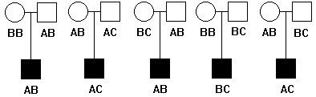
Complex Traits
Cases
controls
Common
polymorphism
Rare
variant

Slide 28
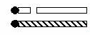
Genetic Variation
Microsatellites (linkage markers)
SNPs/SNVs (association markers, causative variation)
in/dels, CNVs (causative variation)
CAGCAGCAG
CAGCAGCAGCAG
CAGCAGCAGCAGCAG
CAGCAGCAGCAGCAGCAG
ACGTTGGCTCGC
ACGTTGCCTCGC

Slide 29
Complex Traits
Major Common Diseases
Found in most global populations
Frequencies >0.1% (1/1000)
Math:
chronicity x frequency = massive societal burden

Slide 30
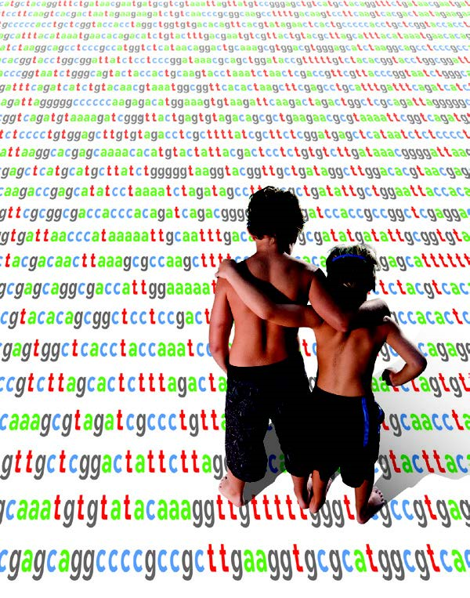
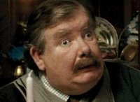

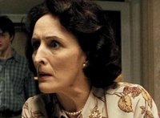

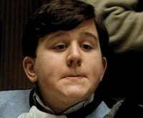

Genetic Epidemiology
Familial aggregation or clustering
Twin studies
Adoption studies
Genome-wide Complex Trait Analysis

Slide 31
Complex Disorders
Disease | λ_{s}
Huntington’s Disease | 5,000
Cystic Fibrosis | 625
Inflammatory Bowel Disease | 60
Autism | 20
Multiple Sclerosis | 20
T1DM | 15
Schizophrenia | 10
Asthma | 6
Prostate Cancer | 5
T2DM | 2-3
Breast Cancer | 2

Slide 32
Genetic Mapping
How are disease genes identified?

Slide 33
Complex Traits
Types of traits
Discrete/Qualitative traits
Presence of disease
Continuous/Quantitative traits
Weight, blood pressure

Slide 34
Complex Disorders
An example of a continuous trait
Height
Assume one locus, without dominance
Assume A=0.50, a=0.50
AA=tall; Aa=intermediate; aa=short
Expect (via p²+2pq+q²=1)
25% AA
50% Aa
25% aa

Slide 35
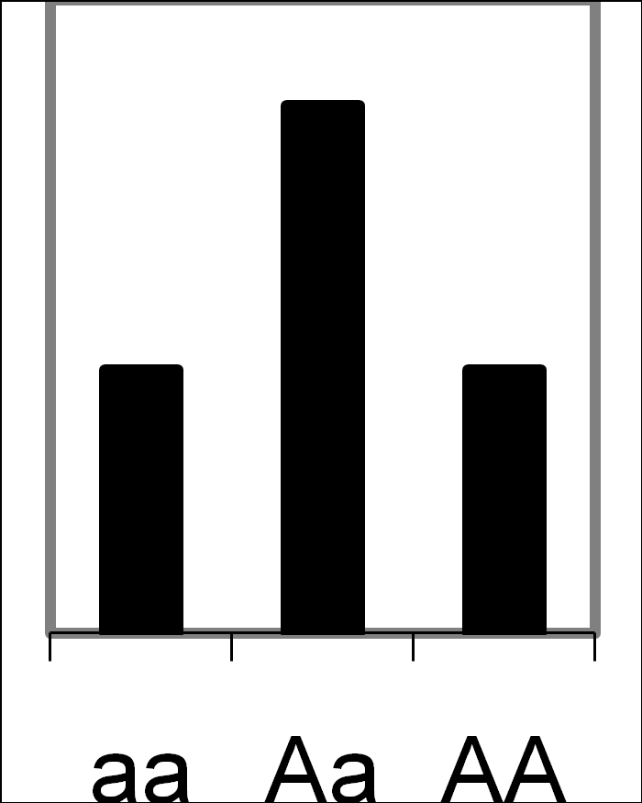
Complex Disorders
Short
Tall

Slide 36
Complex Disorders
Height
Now assume two loci, A and B
Assume B=0.50 and b=0.50 also
Expect 9 genotypes, with an individual having 0-4 “tall” alleles
0=aabb
1=Aabb, aaBb
2=AAbb, AaBb, aaBB
3=AABb, AaBB
4=AABB

Slide 37
Complex Disorders
Short
Tall

Slide 38
Complex Disorders
Short
Tall

Slide 39
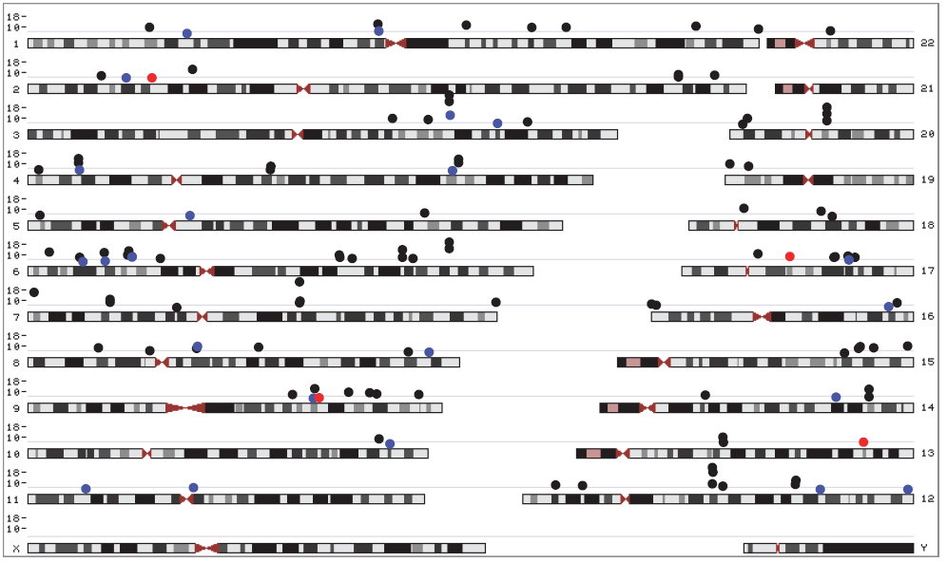
Complex Disorders
(Alleles associated with human height)
Shriner et al, 2009

Slide 40
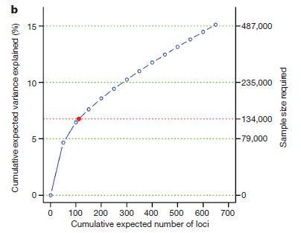
Complex Disorders
Height loci expected to be discovered.
The dotted red line corresponds to expected phenotypic variance explained by the 110 loci that reached genome-wide significance and were replicated.
Lango Allen et al, 2010, Nature

Slide 41
Complex Disorders
Modes of inheritance
Simple Mendelian inheritance
Single major locus
Oligogenic
Polygenic
Mixed model

Slide 42
Human History
Architecture likely influenced by:
disease pleiotropy
selection
population history
chance

Slide 43

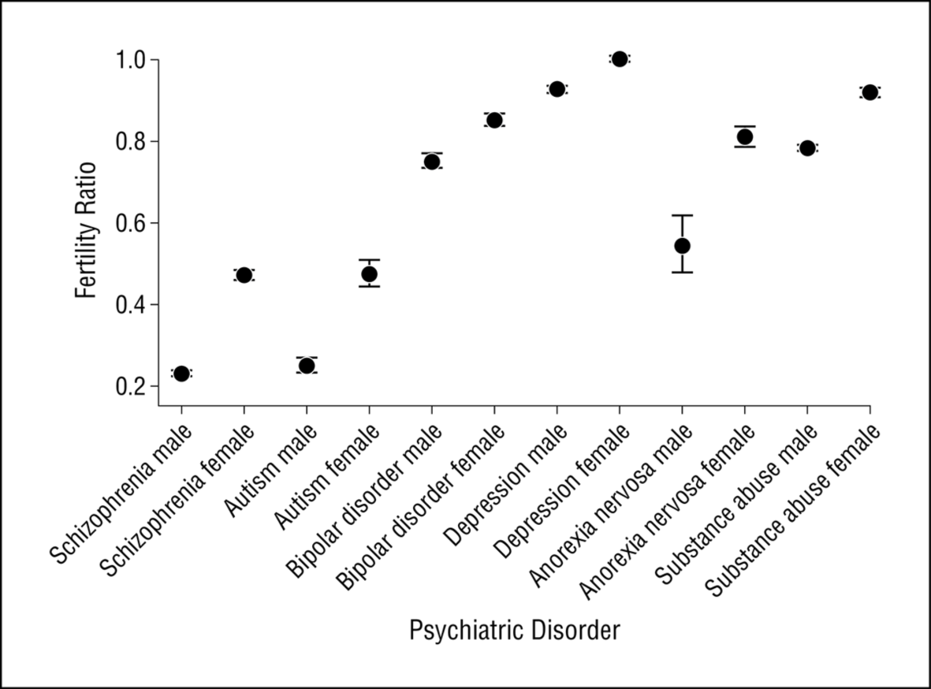
From: Fecundity of Patients With Schizophrenia, Autism, Bipolar Disorder, Depression, Anorexia Nervosa, or Substance Abuse vs Their Unaffected Siblings
JAMA Psychiatry. 2013;70(1):22-30. doi:10.1001/jamapsychiatry.2013.268
Ramifications:
Common and low frequency variants can be plentiful at very low effect sizes (OR < 1.1)
Large effect alleles must be extremely rare
Figure Legend:
Figure 1. Fertility ratios for individuals with schizophrenia, autism, bipolar disorder, depression, anorexia nervosa, and substance abuse. A fertility ratio of 1 (highlighted) represents that of the general population.

Slide 44
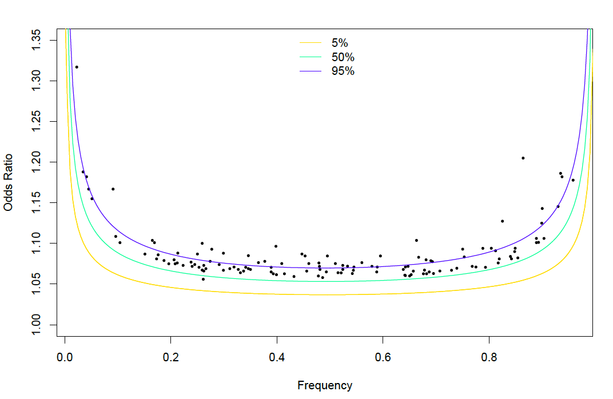
Common variants can abound, but only at extremely modest ORs permitted by this selective pressure
Odds-ratio vs risk allele frequency, PGC-schizophrenia 2014 results
(N ~ 35,000 cases, n=128 genome-wide significant variants)

Slide 45
Gene Mapping

Slide 46
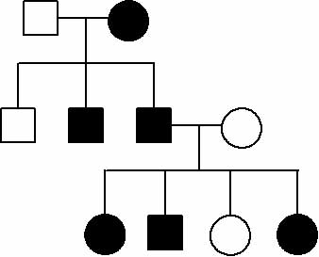
Linkage Studies
Robust to allelic heterogeneity
Implicate large regions
Need multiplex family data

Slide 47
Association Studies
only look at common polymorphisms
Usually case-control (requires matching)
case
control
A
0.61
0.28
B
0.39
0.72

Slide 48
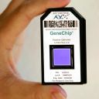
Genome-wide Association
Common polymorphisms
Usually case-control
(also family-based association)
LARGE sample size required
10,000s to 100,000s
MANY markers across the genome
500,000 to 1,000,000

Slide 49
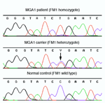
Mutation Screening
Can detect rare variants
Requires strong candidate genes
Results often difficult to interpret
G G G T A T C C/T G A A T C
GGGTATCTGAATC
GGGTATCTGAATC
GGGTATCCGAATC
GGGTATCTGAATC
GGGTATCCGAATC
GGGTATCCGAATC

Slide 50
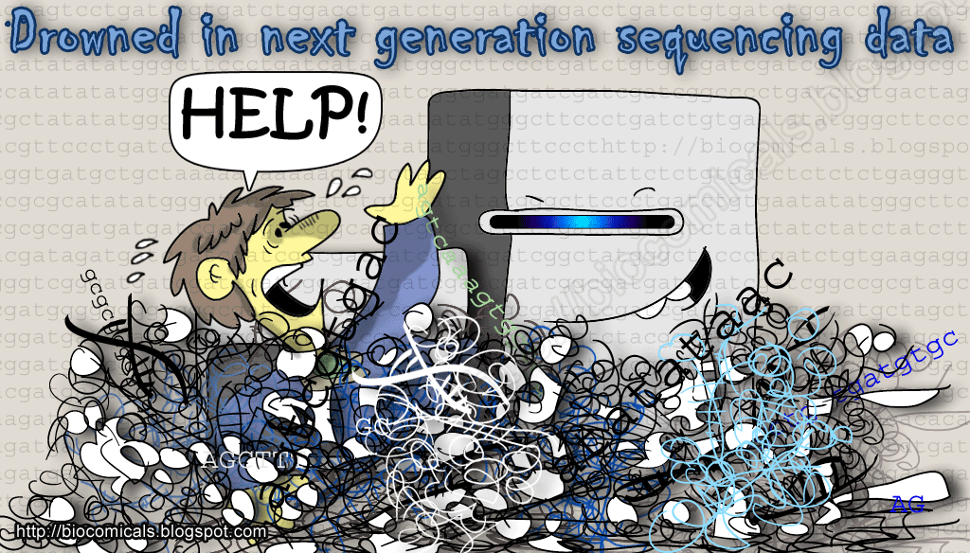
Genome/Exome Sequencing
Can detect rare and common variants
Requires strong models
Results often difficult to interpret

Slide 51
Association
what is “association”?
Two variables are mutually dependent if the value of one variable depends on the value of the other variable: they are associated
Correlation
Association ≠ causation

Slide 52
Association
Confounding
In San Francisco:
Do more fire engines cause more fire damage?
Something else explains connection between fire engines and fire damage

Slide 53
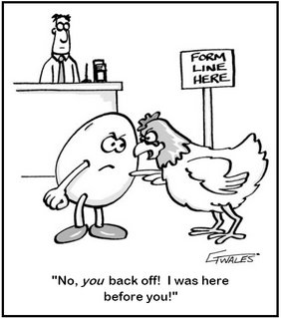
Association
Genetic association

Slide 54
Association
Three types of association
Direct Association
Mutant or ‘susceptibility’ allele
Allele of interest is itself involved in phenotype
Indirect Association
Allele itself is not involved, but a nearby correlated marker changes phenotype
Spurious association
Apparent association not related to genetic etiology—stratification based on ancestry

Slide 55
Association
Population based
Match cases & controls

Slide 56
Allelic Association
Genotype
Count alleles
Compare
11
11
12
11
12
11
12
12
11
22
12
11
22
11
11
22
12
11
12
22
Allele 1
Allele 2
11
12
11
12
11
Cases
40
10
50
11
12
22
12
22
Controls
25
25
50
11
11
12
11
11
65
35
22
12
12
12
11
χ² = 8.6, df=1, p=0.003
Odds Ratio = 4.0
11
12
11
11
12
11
12
12
12
12
Cases
Controls

Slide 57
Association
Interpretation
p=0.003, probability that observation was due to chance is 3/1000, or 0.3%
Convention: p < 0.05
Odds Ratio = 4.0, a person is 4x more likely to be a case if they have the “1” allele than if they do not

Slide 58
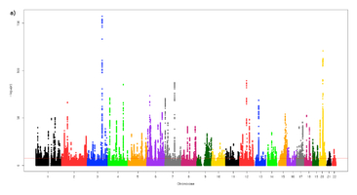
Manhattan Plot

Slide 59
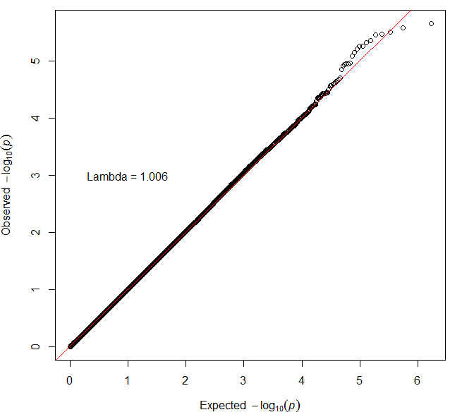
QQ Plot

Slide 60
Questions?

Slide 61
GWAS Exercise (Friday next week)

Slide 62
Files for GWAS lab
Download PLINK 1.9 (https://www.cog-genomics.org/plink/ )
Add PLINK to PATH
Have R ready and updated
Install R package “qqman”
Download exercise files https://www.dropbox.com/sh/b403jhaoegv30d0/AACSGQ8qVjsYy1QmuvWTdcbUa?dl=0
Create folder in Desktop with exercise and PLINK files

Slide 63
Data set
Rheumatoid Arthritis case:control study
868 cases and 1194 are controls
569 males, 1493 females
545,080 SNPs

Slide 64
See you Thursday!

